Slide 1

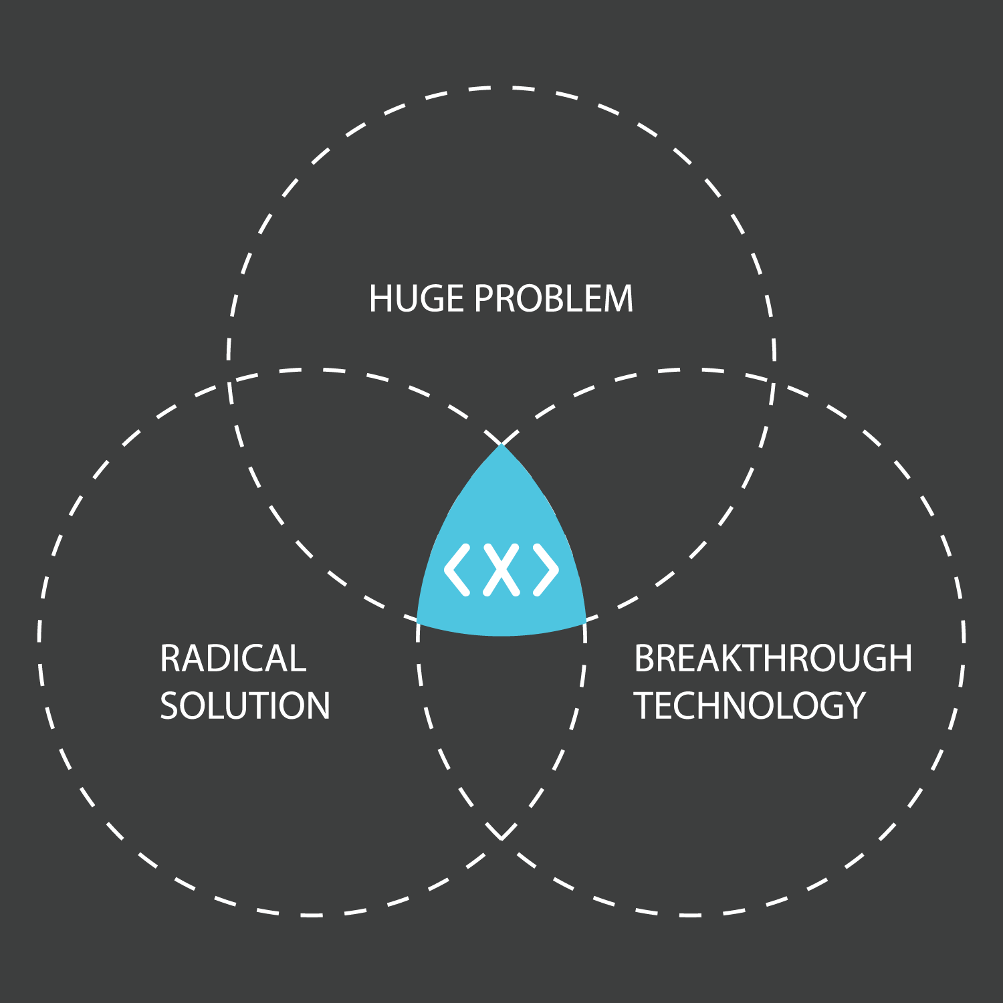










Moonshot Ideation Workshop
A moonshot refers to a project or an initiative that aims to solve a significant problem or create revolutionary new technology. Moonshots are often high-risk, high-reward endeavors that require a commitment of resources and a willingness to take calculated risks.
The importance of moonshots lies in their potential to create significant positive change in the business. By pursuing moonshots, organizations and individuals can drive innovation, create new technologies and industries, and tackle some of the world's most pressing problems. Moonshots encourage individuals and organizations to think big, be bold, and challenge conventional wisdom, leading to breakthroughs that would not have been possible otherwise.
One day workshop Follow up
Step 1
Step 2
Step 4
Step 6
Presentation of current innovation landscape to create a common understanding
Identify business areas
where value is expected
Ideate first set of use cases
with highest value or priority
List of possible next steps and
high-level maturity assessment
Briefing
Problem
Space
Solution
collect
investigation
choose
collect
Space Creation ^{Next Steps}
choose
Step 3
Step 5
Results
Decide on the most
relevant areas
Create a coarse-grained
set of ideas of potential
concepts and prototypes
Common understanding of
landscape, prioritized list of use cases,
summary of workshop results,
definition of next steps in journey
Contact us:
info@infusedinnovations.com
www.infusedinnovations.com

